Slide 1
Hidden Markov Model (HMM)
Chris Kuo, Ph.D.| Columbia University

Slide 2
Anomaly in a sequence
Statement of the problem
Notes:
This is the question that your experiment answers

Slide 3
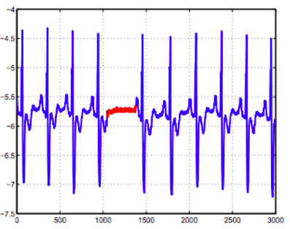
Examples
In our daily life we often see data is in the form of sequences or time series.
In medical examination the Electrocardiogram (ECG) recordings of the patient is a time series. If we detect anomalies in the time series, we understand there is a problem to the heart's condition.
The figure below shows the ECG data of a patient. The red denotes an anomaly because the same low value exists for an abnormally long time (corresponding to an Atrial Premature Contraction).

Slide 4
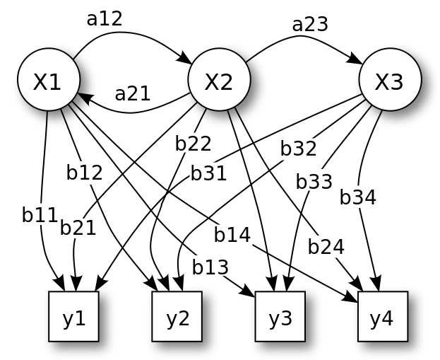
Hidden Markov Model
In our daily life we often see data is in the form of sequences or time series.
Input
Output

Slide 5
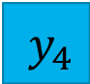
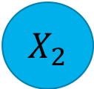
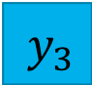

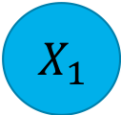
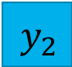



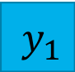
HMM ~ Mixture Model ~ Finite-state HMM
HMM and the mixture model have similar algorithm.
Because there is a finite number of states, hidden markov models are also called finite-state HMM.
Along the mixture models, they can be called Dependent mixture models or Gaussian mixture models for Gaussian distribution.
p
1-p
$$X_{1}$$
$$X_{2}$$
N($μ_{1}$, $δ_{1}$)
N($μ_{2}$, $δ_{2}$)
$$y_{1}$$
$$y_{2}$$
$$y_{3}$$
$$y_{4}$$
pN($μ_{1}$, $δ_{1}$)+ (1-p)N($μ_{2}$, $δ_{2}$)

Slide 6
Hidden Markov Model
Most time series models assume the data is stationary → Caution: this strong assumption is a major weakness of these models.
Instead, HMM does not assume stationary. The expected means and variances are temporarily stationary in a “regime”. When the hidden state moves to another regime, the expected means and variance will be different.
These periods or *regime" can be considered as the hidden states. In this case, all we need to do is to find the true hidden state(s).
Notes:
Most time series models (such as the ARMA models) assume the data is stationary, meaning the expected mean and variances do not change over the entire modeling period. This strong assumption is a major weakness of these models.
Instead, let us approach the problem differently. We have observed that the expected means and variances are temporarily stable from period to period. These periods or *regime" can be considered as the hidden states. In this case, all we need to do is to find the true hidden state(s).
It is worth noting that, the model assumption that the hidden process follows a markovian process is its strength yet also the weakness. If the hidden process does not follow a markovian process, these techniques might fail to capture the anomalies.

Slide 7
Hidden Markov Model
The hidden markov model is a kernel-based framework to detect outliers. This approach can be introduced in a general way for data with latent dependency structure, and, for a specific choice of loss function and kernel function, we obtain a hidden Markov.
Similar to the one-class SVM, HMM has a parameter ν that controls the fraction of the outliers.
R Package for the Dependent Mixture Model – depmixS4

Slide 8
Work cited
depmixS4 in Journal of Statistical Software

